Slide 1
H-Bridges and Stepper Motors
Eric Taseski, Yihe Huang, Ronak Mehta

Slide 2
Standard DC Motors
Speed determined by voltage level.
Vcc
Motor
+ -
- +
GND

Slide 3
Stopping
No movement, holds position.
Vcc
Motor
STOP
GND

Slide 4
Free Spinning
Disconnected, does whatever it wants.
Vcc
Motor
GND

Slide 5
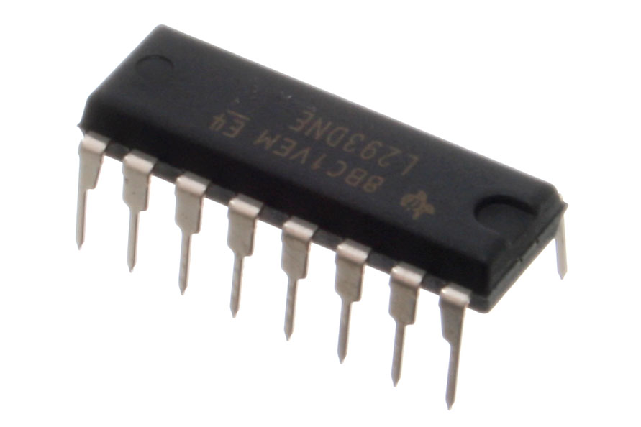
H-Bridges!
Allows low voltage logic while driving external power to motors.
Easily control current in both directions, allowing motors to move forwards and backwards.
Useful for DC motors, stepper motors, servos, solenoids, etc.

Slide 6
H-Bridges
Each half bridge is a transistor with an enable.
LOW Voltage Input Control Logic
HIGH Voltage Output
Motor Voltage
Logic Input
Logic Enable
Motor

Slide 7
H-Bridges
Vcc, Motor Supply Voltage
Input 1
Output 1
EN 1,2
Input 2
Output 2
Input 3
Output 3
EN 3,4
Input 4
Output 4
GND

Slide 8
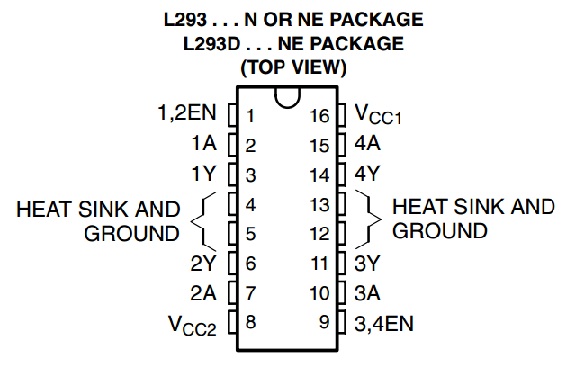
H-Bridge Pinout
-EN pins enable output (1 EN pin per pair)
-A’s are control inputs
-Y’s are outputs
-Vcc1 is circuit logic voltage
-Vcc2 is the motor supply
-Grounds go to ground
http://www.ti.com/lit/ds/symlink/l293d.pdf
Notes:
In most applications, HIGH is driven to the enable pins. Drive Vcc1 with logical HIGH (typically 5V). Drive Vcc2 with motor supply HIGH. Inputs are the A’s, outputs are the Y’s.

Slide 9
Full-Bridge with DC Motor
Input A
1
0
Motor
1
1
Enable
+ -
- +
Input B
0
1
ENABLE | Input A | Input B | Result
1 | 1 | 0 | Motor turns CW
1 | 0 | 1 | Motor turns CCW
1 | 0 or 1 | 0 or 1 | Fast Stop
0 | 0 or 1 | 0 or 1 | Free Spin

Slide 10
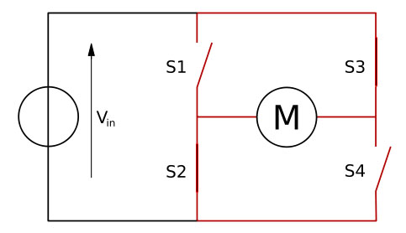
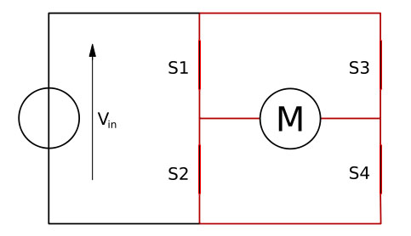
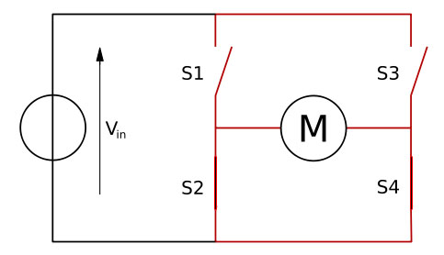
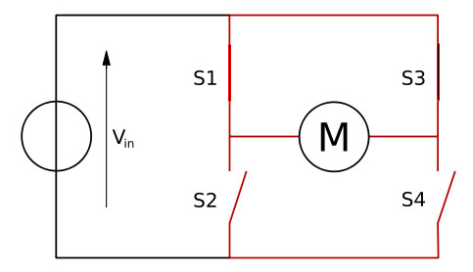
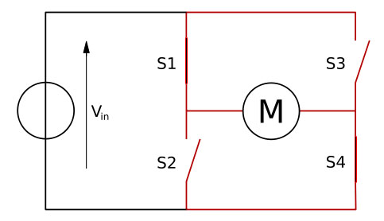
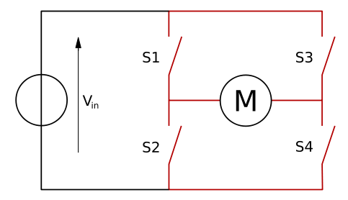
H-Bridge with DC Motor
S1 | S2 | S3 | S4 | Result
1 | 0 | 0 | 1 | Move CW
0 | 1 | 1 | 0 | Move CCW
0 | 0 | 0 | 0 | Free Spin
0 | 1 | 0 | 1 | Brake
1 | 0 | 1 | 0 | Brake
1 | 1 | 0 | 0 | Shoot-through
0 | 0 | 1 | 1 | Shoot-through
1 | 1 | 1 | 1 | Shoot-through
http://en.wikipedia.org/wiki/H_bridge

Slide 11
References
L293D explanation with Stepper Motor details:
http://www.codeproject.com/Articles/151763/Motor-Primer-and-the-L293D-Quad-Half-H-Driver
Stepper motor configurations with microcontroller pins:
http://www.8051projects.net/stepper-motor-interfacing/stepper-motor-connections.php
Microstepping (not covered):
http://homepage.cs.uiowa.edu/~jones/step/micro.html
Different types of stepper motors explained:
http://www.wimb.net/index.php?s=motion&page=52
Stepper wikipedia page:
http://en.wikipedia.org/wiki/Stepper_motor
H-Bridge wikipedia page:
http://en.wikipedia.org/wiki/H_bridge
Adafruit stepper with arduino tutorial:
http://learn.adafruit.com/adafruit-arduino-lesson-16-stepper-motors/breadboard-layout
L293D Datasheet:
http://www.ti.com/lit/ds/symlink/l293d.pdf

